Slide 1

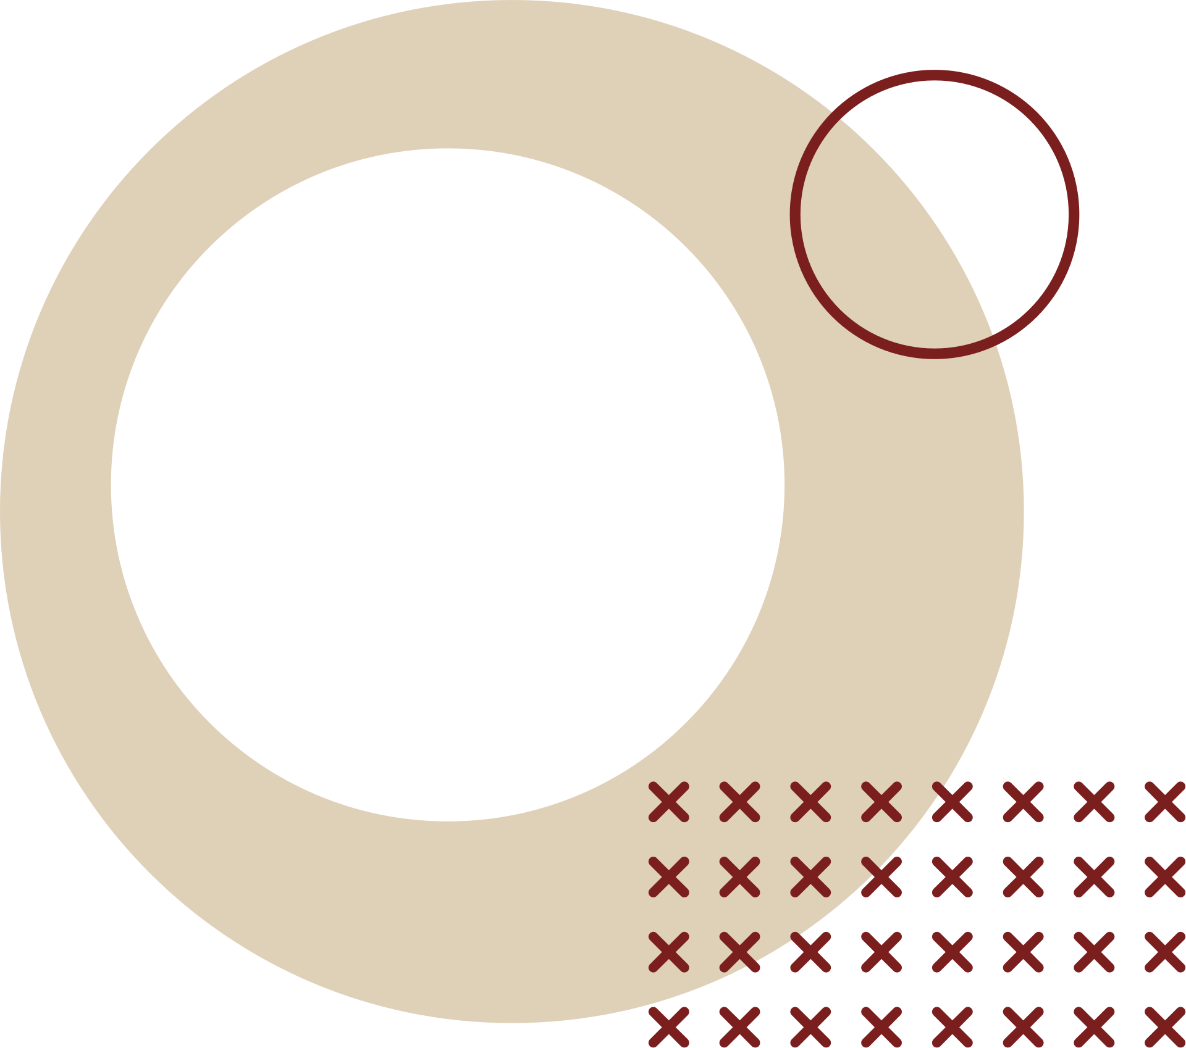
HISTORY AND EVOLUTION OF COMPUTERS
Notes:
Necessity is the mother of invention. The saying holds true for computers too. Although computers seem like a modern invention, computing dates back to the early 1800s. Computers were invented because of human’s search for accurate and fast calculating devices. Basic Pascal invented the first mechanical adding machine in 1642. Later, in 1671, Keyboard machines originated States around 1880, and we use them even today. Around the same period, Herman Hollerith came up with the concept of punched cards that were extensively used as an input medium in computers even in the late 1970s.
A nineteenth-century Professor at Cambridge University, Charles Babbage, is considered the father of modern digital computers. Today computers are different from earlier days based on appearance and performance. However, present-day computers have undergone significant changes for the last seven decades.

Slide 2
EVOLUTION OF COMPUTERS [GENERATIONS OF COMPUTERS]
Notes:
Necessity is the mother of invention. The saying holds true for computers too. Although computers seem like a modern invention, computing dates back to the early 1800s. Computers were invented because of human’s search for accurate and fast calculating devices. Basic Pascal invented the first mechanical adding machine in 1642. Later, in 1671, Keyboard machines originated States around 1880, and we use them even today. Around the same period, Herman Hollerith came up with the concept of punched cards that were extensively used as an input medium in computers even in the late 1970s.
A nineteenth-century Professor at Cambridge University, Charles Babbage, is considered the father of modern digital computers. Today computers are different from earlier days based on appearance and performance. However, present-day computers have undergone significant changes for the last seven decades.

Slide 3
Computer generation is a classification of computers into different groups according to their manufacturing date, memory device, software and hardware technologies. There are five generations of computers. They are as follow:
  First Generation (1942-1955)
  Second Generation (1955-1964)
  Third Generation (1964-1975)
  Fourth Generation (1975-1989)
  Fifth Generation (1989-Present)
Notes:
Primitive people used the first counting device. Earlier, people used their fingers, stones, bones, and pebbles as counting tools to do calculations. More computing devices were developed as the human mind and technology improved with time. The first use of the word “Computer” was documented in 1613, referring to an individual who carried out calculations or computations, and the term persisted in being used in that sense until the middle of the 20th century.

Slide 4
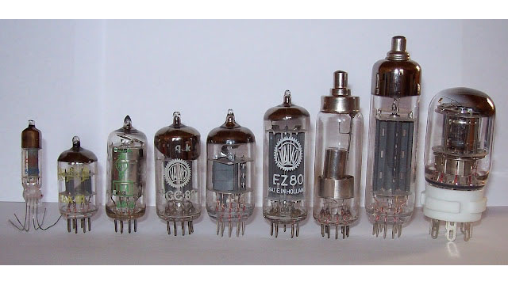
1.THE FIRST GENERATION COMPUTERS (1945-1956 AD)
First-generation computers bore little resemblance to today’s computers, either in appearance or performance. The first generation of computers occurred from 1940 AD to 1956 AD and was extremely large in size. These early machines required vacuum tubes that worked as switches, amplifiers, and magnetic drums for memory. The paper tapes and punch cards were used for input and printouts for output.
Notes:
First-generation computers bore little resemblance to today’s computers, either in appearance or performance. The first generation of computers occurred from 1940 AD to 1956 AD and was extremely large in size. The internal workings of the computers at that time were unsophisticated. These early machines required vacuum tubes that worked as switches, amplifiers, and magnetic drums for memory. The paper tapes and punch cards were used for input and printouts for output.

Slide 5
FEATURES OF FIRST GENERATION COMPUTERS
It was a large mainframe built with vacuum tube technology.
It occupied large space, was low efficiency and unreliable due to low accuracy.
The power consumption was very high, and it produced massive heat.
The operation of speed was in milliseconds.
It was used only for scientific or research purposes.
Low-level programming language was used in computers.
They were very slow.

Slide 6
LIMITATIONS OF FIRST GENERATION COMPUTERS
The computer needed an air conditioner room, and constant maintenance.
They were not portable.
It was expensive commercial product.
They have minimum programming capabilities.
The computers have limited uses only.

Slide 7
EXAMPLES OF FIRST GENERATION COMPUTERS
ENIAC (Electronic Numerical Integrator and Calculator)
EDVAC (Electronic Discrete Variable Automatic)
UNIVAC (Universal Automatic Computers)
IBM-701
IBM-650

Slide 8
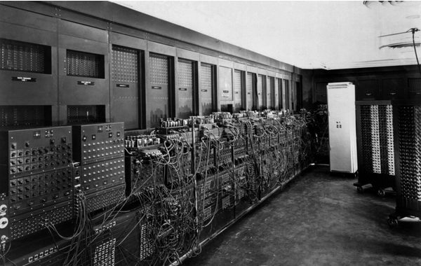
ENIAC (ELECTRONIC NUMERICAL INTEGRATOR AND CALCULATOR) (1943-46 AD)
The Electronic Numerical Integrator And Calculator (ENIAC) was the first all-electronic computer. It was constructed at the Moore School of Engineering of the University of Pennsylvania, U.S.A., by a design team led by Professors J. Presper Eckert and John Mauchly.
Notes:
The Electronic Numerical Integrator And Calculator (ENIAC) was the first all-electronic computer. It was constructed at the Moore School of Engineering of the University of Pennsylvania, U.S.A., by a design team led by Professors J. Presper Eckert and John Mauchly.
The team developed ENIAC because of military needs. It was used for many years to solve ballistic-related problems. ENIAC took up wall space in a 20 x 40 square feet room and used 18,000 vacuum tubes. It could add two numbers in 200 microseconds and multiply them in 2000 microseconds.

Slide 9
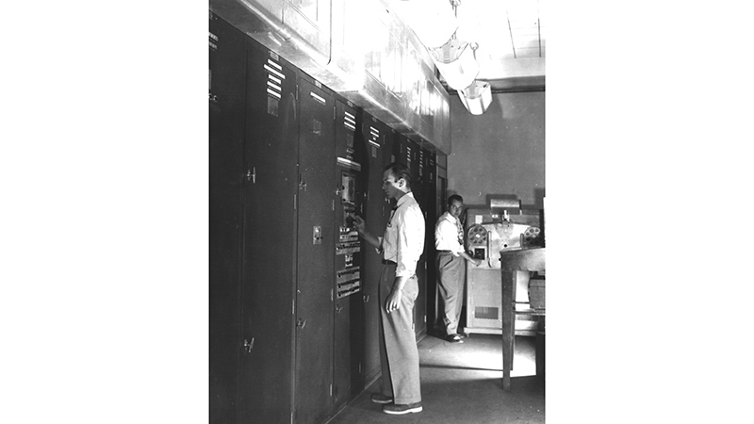
EDVAC (ELECTRONIC DISCRETE VARIABLE AUTOMATIC) (1946-52 AD)
Dr. John Von Neumann later introduced the ―stored program concept that aided overcome this problem. The basic idea after this concept is that a sequence of instructions and data can be stored in a computer’s memory to direct operations flow automatically. This feature largely influenced the development of modern digital computers because of how various programs can be loaded and executed on the same computer.
Notes:
A major disadvantage of ENIAC was that its programs were wired on boards which made it difficult to change the programs. Dr. John Von Neumann later introduced the ―stored program concept that aided overcome this problem. The basic idea after this concept is that a sequence of instructions and data can be stored in a computer’s memory to direct operations flow automatically. This feature largely influenced the development of modern digital computers because of how various programs can be loaded and executed on the same computer. Because of this feature, we usually refer to modern digital computers as stored-program digital computers.
The Electronic Discrete Variable Automatic Computer (EDVAC) used the stored’ program concept in its design. Von Neumann also has a share of the credit for introducing the idea of storing both instructions and data in binary form (a system that uses only two digits – 0 and 1 to represent all characters), instead of decimal numbers or human-readable words.

Slide 10
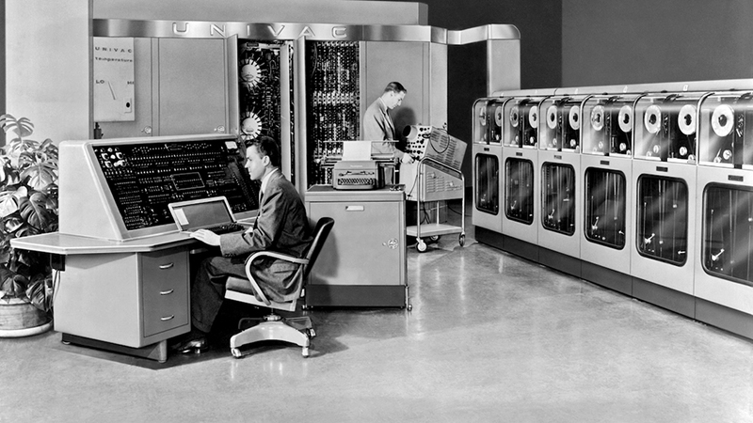
UNIVAC (UNIVERSAL AUTOMATIC COMPUTERS) (1951)
The Universal Automatic Computer (UNIVAC) was the first digital computer that was not ―one of a kind. Many UNIVAC machines were manufactured, the first of which was installed in the Census Bureau in 1951 and was used continually for 10 years.
In 1952, the International Business Machines (IBM) Corporation introduced the IBM-701 commercial computer. In quick succession, improved models of the UNIVAC I and other IBM 700-series machines were introduced. In 1953, IBM produced the IBM-650 and sold over 1000 computers.
Notes:
The Universal Automatic Computer (UNIVAC) was the first digital computer that was not ―one of a kind. Many UNIVAC machines were manufactured, the first of which was installed in the Census Bureau in 1951 and was used continually for 10 years.
In 1952, the International Business Machines (IBM) Corporation introduced the IBM-701 commercial computer. In quick succession, improved models of the UNIVAC I and other IBM 700-series machines were introduced. In 1953, IBM produced the IBM-650 and sold over 1000 computers.
UNIVAC marked the arrival of commercially available digital computers for business and scientific applications and was developed by General Electric Corporation in 1954.

Slide 11
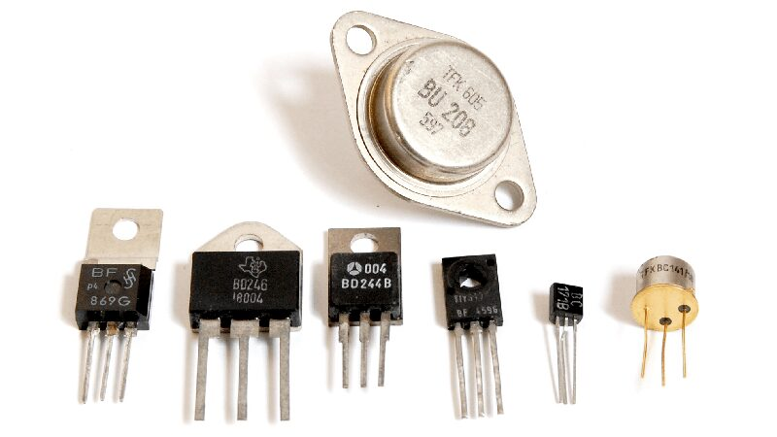
2.SECOND GENERATION COMPUTERS (1956-1963 AD)
The interest in computer technology got fast after the first-generation computers. It was the generation of Transistorized Computers. Transistors replaced vacuum tubes from the first generation computers. As a result, first-generation computers were replaced by second-generation computers.
Notes:
The interest in computer technology got fast after the first-generation computers. It was the generation of Transistorized Computers. Transistors replaced vacuum tubes from the first generation computers. As a result, first-generation computers were replaced by second-generation computers.
The transistors were more reliable than vacuum tubes, smaller in size, faster in speed, and cheap[er than first-generation computers. Magnetic drums are replaced by magnetic disks and magnetic tape for secondary storage. As a result, the size of the machines began shrinking.

Slide 12
The first transistorized computer was TX-0. The first large-scale machines that took advantage of the transistor technology were the early supercomputers, LARC by Sperry Rand and Stretch by IBM. These machines were specially developed for atomic energy laboratories. IBM 1400 and IBM 7000 series, General Electric, and Honeywell 200 were the typical computers of the second generation.
IBM 1401 was accepted throughout the industry, and most prominent businesses routinely processed financial information using second-generation computers.
High-level languages like FORTRAN, COBOL, and AL- GOL were developed. Computers started finding varied and vast applications. The entire software industry began with second-generation computers.
Notes:
The first transistorized computer was TX-0. The first large-scale machines that took advantage of the transistor technology were the early supercomputers, LARC by Sperry Rand and Stretch by IBM. These machines were specially developed for atomic energy laboratories. IBM 1400 and IBM 7000 series, General Electric, and Honeywell 200 were the typical computers of the second generation.
IBM 1401 was accepted throughout the industry, and most prominent businesses routinely processed financial information using second-generation computers. The machine language was replaced by assembly language. Thus the long and challenging binary code was replaced with abbreviated programming code, which was relatively easy to understand.
High-level languages like FORTRAN, COBOL, and AL- GOL were developed. Computers started finding varied and vast applications. The entire software industry began with second-generation computers.

Slide 13
FEATURES OF SECOND GENERATION COMPUTERS
  This generation’s most significant feature was introducing transistors that make the size smaller than the first-generation computer.
  The computer was much faster, more reliable, and better speed and could handle enormous data than first-generation computers.
  The machine-level language was replaced by assembly language and machine-independent language such as COBOL FORTRAN to simplify programming.
  The significant change is in speed from millisecond to microsecond.
  The computer consumes less electrical power than a first-generation computer.
  The computer is widely used in commercial areas.

Slide 14
LIMITATIONS OF SECOND GENERATION COMPUTERS
  It still used a cooling system to cool down the computer.
  It needs constant maintenance.
  Punch cards are still used for inputs.
  It was still costly and versatile.

Slide 15
EXAMPLES OF SECOND GENERATION COMPUTERS
  IBM 1401 (Used in Business Application)
  IBM 1620 (Used for Scientific Purposes)
  CDC 3600 (Used for Scientific Purposes)
  IBM 7000
  Honeywell 200

Slide 16
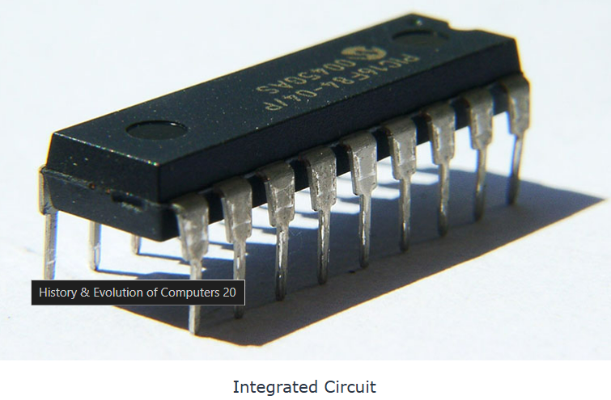
3.THIRD GENERATION COMPUTERS (1964-1971 AD)
Third-generation computers were characterized by the invention of Integrated Circuits (ICs). IC is a silicon chip made from quartz where multiple transistors were placed over it. Robert Noyce and Jack Kilby developed IC at Texas Instrument in 1958-1959. Later, even more components were rigged onto a single chip, called a semiconductor. It reduced the size even further in the third generation computers. Computers’ weight and power consumption decreased, and the speed boosted.
Notes:
Its period was around 1964 to 1971. Third-generation computers were characterized by the invention of Integrated Circuits (ICs). IC is a silicon chip made from quartz where multiple transistors were placed over it. Robert Noyce and Jack Kilby developed IC at Texas Instrument in 1958-1959. Later, even more components were rigged onto a single chip, called a semiconductor. It reduced the size even further in the third generation computers. Computers’ weight and power consumption decreased, and the speed boosted.
Operating systems were created, allowing the machine to run many different programs simultaneously. Multiprogramming was made possible, whereby the device could perform several jobs simultaneously.
Computers gained the speed of executing millions of instructions per second. Commercial production became more accessible and cheaper. Higher-level languages like Pascal and Report Program Generator (RPG) were introduced. And applications-oriented languages like FORTRAN, COBOL, and PL/1 were developed. Keyboards and mouse were introduced for the input of data. The monitor was introduced for the output of data.

Slide 17
FEATURES OF THIRD GENERATION COMPUTERS
  IC was used in the computer, replacing transistors.
  The mass audience was using computers.
  The computers were highly reliable, relatively inexpensive, faster, and more accurate.
  It can be operated with low energy, and maintenance cost was low also.
  The keyboard and monitor were introduced for data input and output.
  It had a more prominent space capacity.
  A computer has more high-level computer language such as ALGOL-68, FORTRAN-II TO IV, BASIC, COBOL, PASCAL PL/1.
  They were produced commercially and was cheaper than both generations of computer.

Slide 18
LIMITATIONS OF THIRD GENERATION COMPUTERS
  Still, the air conditioner is used for cooling purposes.
  Highly sophisticated technology was required for the maintenance of the ICS chip.
  For third-generation computers, formal training was needed.

Slide 19
EXAMPLES OF THIRD GENERATION COMPUTERS
  IBM 360 SERIES
  IBM 370
  UNIVAC 1108
  UNIVAC AC 9000
  PDP-8, PDP-11
  ICL 2900 series, and so on.

Slide 20
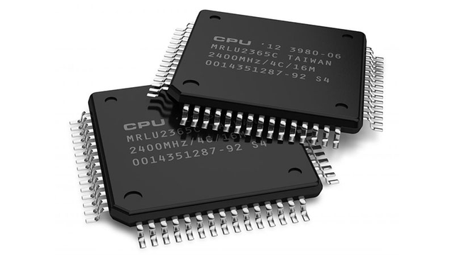
4.FOURTH GENERATION COMPUTERS (1971 - PRESENT)
The Fourth Generation acknowledged Large Scale Integration (LSI), which could hold hundreds of components on one chip, and Very Large Scale Integration (VLSI), which embraced thousand of components on one silicon chip. The Intel 4004 chip hold all the components of a computer (central processing unit (CPU), input and output controls, memory unit) on a single chip called a Microprocessor, and microcomputers were introduced.
In 1981, IBM introduced its personal computer for home, office, and schools. In direct competition, the Macintosh was introduced in 1984 by Apple. Shared interactive systems and user-friendly environments were the features of these computers.
Notes:
The fourth-generation computers were developed from 1971 to 1990 AD. The present-day computer we see is the fourth generation of computers. The third generation computers used Integrated Circuits with 10-20 components on each chip; this was Small Scale Integration (SSI). The Fourth Generation acknowledged Large Scale Integration (LSI), which could hold hundreds of components on one chip, and Very Large Scale Integration (VLSI), which embraced thousand of components on one silicon chip.
The Intel 4004 chip hold all the components of a computer (central processing unit (CPU), input and output controls, memory unit) on a single chip called a Microprocessor, and microcomputers were introduced.
In this generation, the concept of computer networks and CD-ROMS come into existence. GUI and pointing devices facilitate easy use and learning on the computer. Many new operating systems like the MS-DOS and MS-Windows developed during this time. Computer production became affordable, and the era of Personal Computers (PCs) began.
In 1981, IBM introduced its personal computer for home, office, and schools. In direct competition, the Macintosh was introduced in 1984 by Apple. Shared interactive systems and user-friendly environments were the features of these computers.

Slide 21
FEATURES OF FOURTH GENERATION COMPUTERS
  Computer sizes change from desktop to laptop and from laptop to palmtop.
  Electronic Mail (E-mail) and the Internet were developed in this generation.
  The computer is used for all scientific, engineering, and commercial purposes.
  On the computer, we can perform multiprocessing and multitasking.
  The computer has GUI (Graphical User Interface) and is user-friendly.
  Multiple high-level languages like PASCAL, BASIC COBOL, FORTRAN, and C language were developed in this generation of computers.
  They emerged as single-board computers and a single-chip processor called Microprocessors.

Slide 22
LIMITATIONS OF FOURTH GENERATION COMPUTERS
  They were highly sophisticated.
  The manufacturing of a Very Large-Scale Integration Chip needed very advanced technology.

Slide 23
EXAMPLES OF THIRD GENERATION COMPUTERS
  MAC Notebook
  IBM-PC
  Pentium I, II, & III
  Apple II
  VAX 9000
  CRAY 1

Slide 24
5.FIFTH GENERATION COMPUTERS (PRESENT - FUTURE)
Tomorrow’s computers would be characterized by Artificial Intelligence (AI) and ULSI (Ultra Large-Scale Integration) technology that can store millions of components in a single chip. An example of Al is Expert Systems. Computers could be developed to think and sense much the same way as humans. Computers would be able to accept verbal words as input (voice recognition).
Numerous advancements in the science of computer design and technology are coming together to enable the creation of fifth-generation computers. Two such advances are in superconductor technology that allows electricity flow with little or no resistance, significantly enhancing the speed of information flow, and advances in parallel processing, where many CPUs work as one.
Notes:
Defining the fifth generation of computers is tricky because the field is still in its infancy. Tomorrow’s computers would be characterized by Artificial Intelligence (AI) and ULSI (Ultra Large-Scale Integration) technology that can store millions of components in a single chip. An example of Al is Expert Systems. Computers could be developed to think and sense much the same way as humans. Computers would be able to accept verbal words as input (voice recognition).
Numerous advancements in the science of computer design and technology are coming together to enable the creation of fifth-generation computers. Two such advances are in superconductor technology that allows electricity flow with little or no resistance, significantly enhancing the speed of information flow, and advances in parallel processing, where many CPUs work as one.
Scientists are now working on fifth-generation computers – a promise but not yet a reality. They seek to bring us machines with genuine I.Q., the ability to reason logically, and real-world knowledge.

Slide 25
FEATURES OF FIFTH GENERATION COMPUTERS
  These machines will incorporate ULSI (Ultra Large Scale Integration).
  It can perform a large number of parallel processing.
  The speed of this generation of computers is going to be very high.
  Bio-chips and Gallium Arsenide (GaAs) are used as memory devices.
  The concept of AI (Artificial Intelligence) has been introduced.
  This generation of computers can understand human language and recognize pictures and graphs.

Slide 26
LIMITATIONS OF FIFTH GENERATION COMPUTERS
  The major limitation of this generation is that the computer will overtake all employment, creating unemployment in the country.
  The highly advanced robots can overtake the world, which leads to destruction for humans.

